Slide 1


Slide 2
1
About us
contents
2
What is red light therapy
3
The benefit of red light therapy
4
RLT machine
5
RLT & Methylene blue

Slide 3
About Body Energy Medicine
01

Slide 4
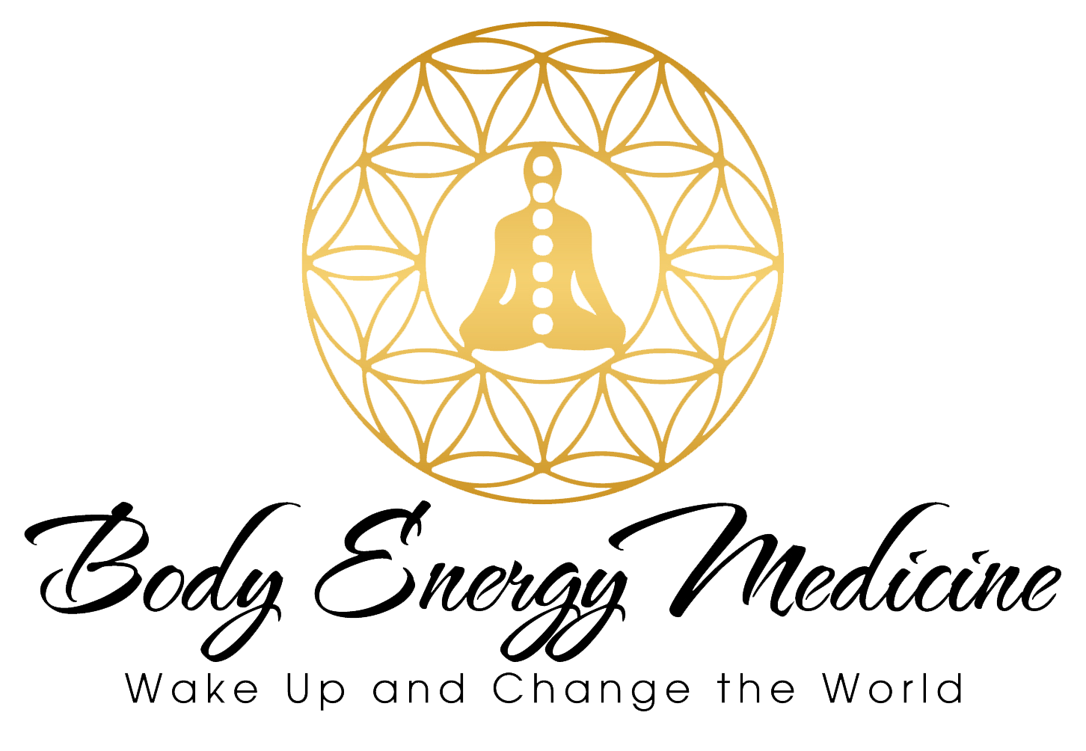
01
About us
About Our Company
Welcome to Body Energy Medicine, where science meets wellness and innovation illuminates’health.
Our Vision
Who We Are
At Body Energy Medicine, we envision a world where cutting-edge technology merges seamlessly with holistic well-being. Our mission is to empower individuals to thrive by harnessing the power of light.
We are a passionate team of wellness enthusiasts. Our journey began with a shared curiosity: How can light transform lives? The answer lies in photo biomodulation.

Slide 5
01
About us
What We Do
We don’t just create products; we pioneer solutions. Our research-driven approach ensures that every bed is backed by scientific evidence. From tissue repair to mood enhancement, our technology is rooted in rigorous studies.
Science-Backed Solutions
Our state-of-the-art beds combine precision engineering, therapeutic wavelengths, and ergonomic design. Whether you’re an athlete recovering from intense training or seeking overall vitality, our beds deliver targeted benefits.
Advanced Photo biomodulation Beds
No two individuals are alike. That’s why our beds offer customizable settings. Tailor your session to address specific needs—whether it’s muscle recovery, skin rejuvenation, or stress reduction.
Personalized Wellness

Slide 6
01
About us
Why Choose Us?
Quality Craftsmanship
Client-Centric Approach
Expertise
Each bed is meticulously crafted, blending aesthetics with functionality. We believe wellness should be a beautiful experience.
Our team includes leading experts in photo biomodulation. We stay ahead of the curve, constantly refining our technology.
Your well-being is our priority. We’re here to guide you, answer your questions, and ensure you get the most out of our products.

Slide 7
What Is Red Light Therapy
02

Slide 8

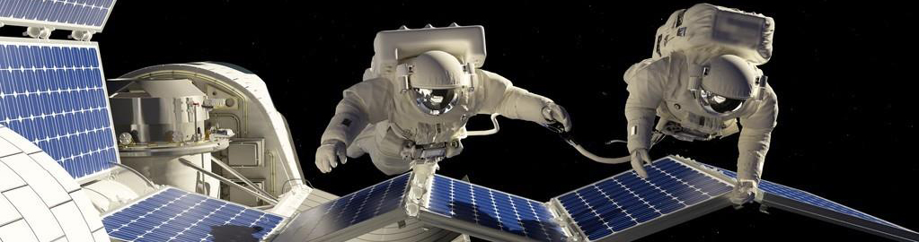

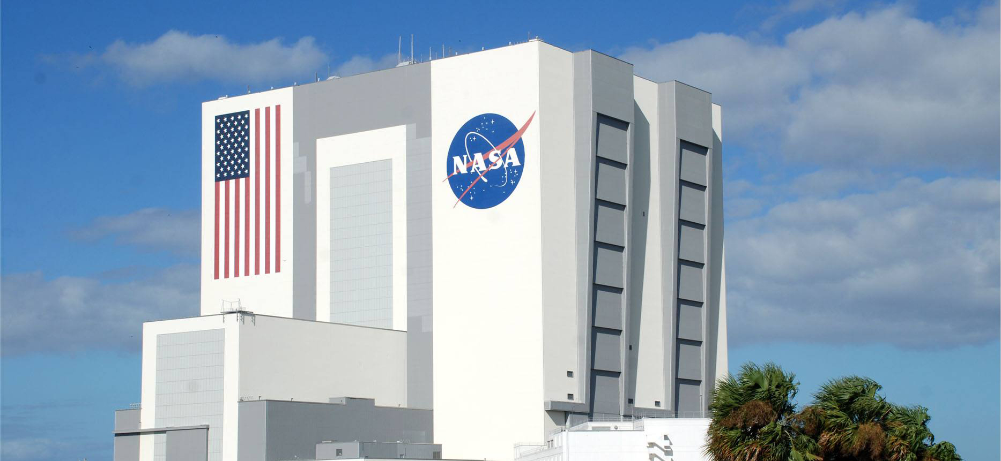
02
What is red light therapy
BEGINNING
Red light therapy technology originated in the 1980s. NASA used LED array light sources (630～800nm)
in spaceships to restore the astronaut's muscles and bones and accelerate the healing of wounds, got good results.
NASA also used LED PDT (photodynamic therapy) technology for early detection and prevention of tumors in astronauts who may be affected by cosmic rays .

Slide 9
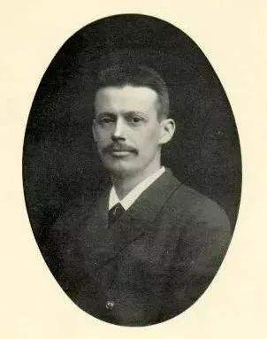
02
What is red light therapy
DEVELOP
Later, the study of light wave found that different wavelengths of light energy can activate the activity of cells, accelerate the metabolism.
Danish medical expert Niels Lubery Finsen kicks off the prologue of photodynamic therapy and Stan Pavel (the scientist in the Department of Dermatology and professor of Dermatology at the Leiden University Medical Center in the Netherlands), applies photodynamic physiotherapy technology to clinical disease treatment.
Niels Ryberg Finsen
1903 Nobel Prize in Physiology or Medicine
15th, Dec., 1860－24th, Sep., 1904

Slide 10
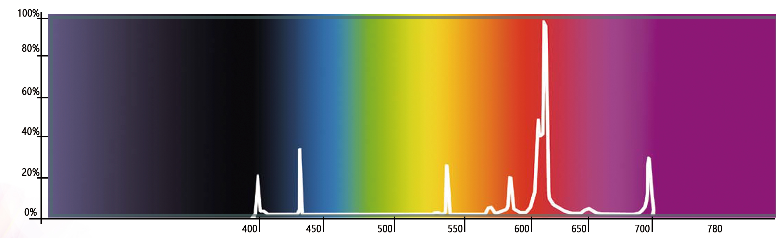
02
What is red light therapy
OVERVIEW
Red light therapy is choosing the integrated light waves combine with above 90% visible light （600-700nm ）and 10% infrared light（700-4000nm). Scientific research has shown that using this integrated light to irradiate body, convert light energy into heat energy and chemical energy. As a result, a series of chain reactions such as photolysis, photooxidation, photopolymerization and photosensitization occur in the body, Thereby producing important biological effects and achieving certain therapeutic effects.

Slide 11
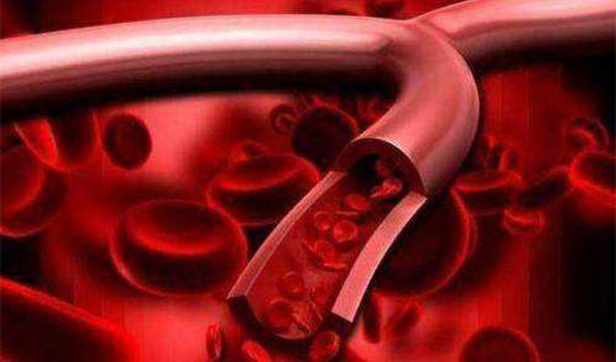
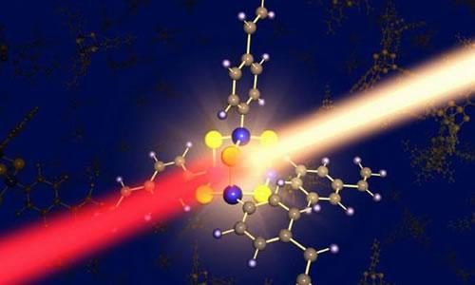
02
What is red light therapy
Technical principle
Red light therapy is the use of specific wavelengths of light waves to cause the vibration of molecules to produce thermal effects, promote the absorption of various elements in the body and unblock the microcirculation channels.
Make the blood circulation smooth, accelerate the elimination of sick or dead cells, promote metabolism and the body's self-healing function and cell regeneration ability, can be used for auxiliary treatment of cardiovascular and cerebrovascular diseases, pain, inflammation and other diseases, as well as improve the body's immunity, health care and eliminate sub-health.

Slide 12
02
What is red light therapy
Technical principle
Red light therapy can convert light energy into biological energy, effectively acting on the mitochondria of subcutaneous tissue cells, producing a highly efficient photochemical biological reaction: enzymatic reaction. Activating cytochrome oxidase C in mitochondria, and generating more energy to accelerate the synthesis of DNA and RNA, and promote the formation of a large amount of collagen and fibrous tissue, thereby repairing damaged skin cells.
It also strengthens the skin through a broadband spectrum, promotes the formation of fibroblasts, and phagocytize the pigment cells, gradually whitening the complexion, and make the dull skin become transparent and radiant.

Slide 13
The Benefit Of Red Light Therapy
03

Slide 14
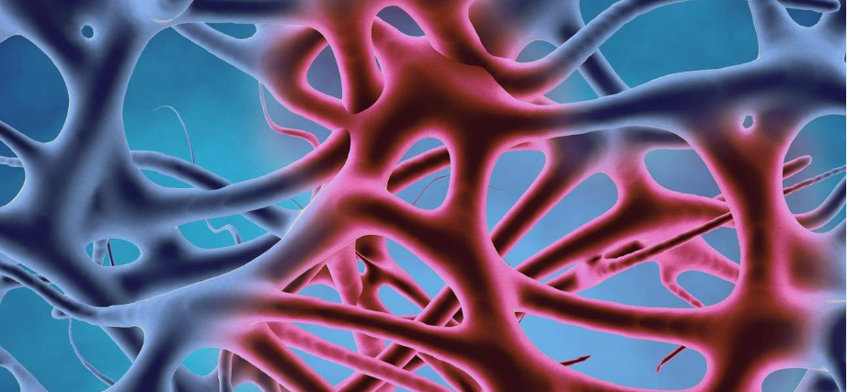

03
The Benefit Of Red Light Therapy
Reduction of Inflammation
Beyond its direct immunomodulatory effects, red light therapy has been found to facilitate tissue repair processes. By promoting the production of collagen and enhancing cellular metabolism, red light therapy accelerates wound healing and tissue regeneration. This dual action on both the immune system and tissue repair mechanisms underscores the therapeutic potential of red light therapy in treating inflammatory conditions and promoting overall tissue health. Continued research into its mechanisms of action and clinical applications holds promise for further unlocking the therapeutic benefits of red light therapy in various medical contexts.
Muscle Recovery and Performance Enhancement
Moreover, emerging research hints at the potential of red light therapy to not only enhance muscle recovery but also to bolster muscle strength and endurance, providing athletes with a competitive edge in their training regimens. This multifaceted approach to muscle recovery and performance enhancement underscores the versatility of red light therapy as a complementary intervention in sports and fitness settings. As its efficacy continues to be elucidated through ongoing research, red light therapy stands poised to play an increasingly integral role in optimizing athletic training and promoting peak physical performance.

Slide 15
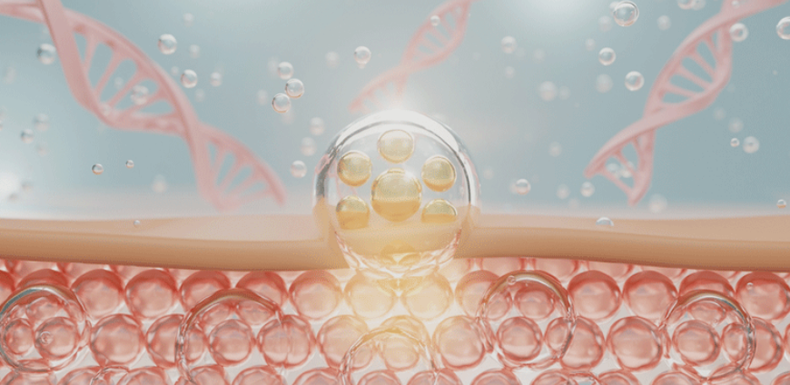
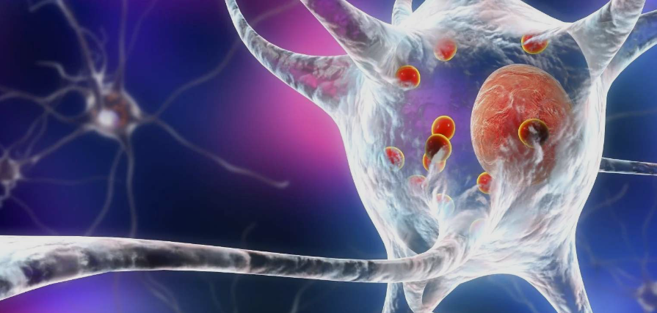
03
The Benefit Of Red Light Therapy
Collagen Production and Skin Health
Red Light Therapy (RLT) stimulates collagen production in the skin, which contributes to improved skin health and appearance. When specific wavelengths of red and near-infrared light are absorbed by skin cells, they trigger a cascade of cellular processes that result in increased collagen synthesis. This leads to firmer, smoother, and more youthful-looking skin, while also helping to reduce the appearance of fine lines, wrinkles, and scars. RLT offers a non-invasive and effective approach for enhancing overall skin health and promoting a radiant complexion.
Neuroprotection and Brain Health
Red Light Therapy (RLT) shows promise for neuroprotection and brain health by enhancing mitochondrial function, reducing oxidative stress, and promoting neuroplasticity. By stimulating cellular activity in the brain, RLT may help safeguard neurons, improve cognitive function, and potentially mitigate the progression of neurodegenerative diseases. Its non-invasive nature and potential efficacy make it an attractive avenue for promoting brain health and resilience.

Slide 16

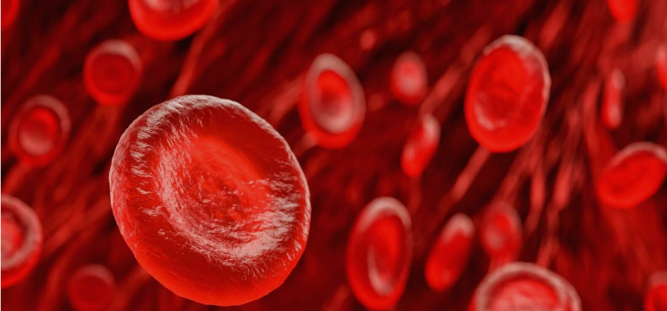
03
The Benefit Of Red Light Therapy
Increased Blood Circulation
Hair Growth
Red Light Therapy (RLT) also promote faster healing and tissue regeneration by facilitating the transportation of essential nutrients and oxygen to the cells. Angiogenesis, the formation of new blood vessels, is a critical process in wound healing and tissue repair. By stimulating angiogenesis, red light therapy supports the development of a robust network of blood vessels, ensuring adequate blood supply to the affected area. This not only accelerates the healing process but also helps to maintain the health and vitality of the surrounding tissues.
Red light therapy has emerged as a compelling non-invasive option in the realm of hair loss treatment, particularly for conditions such as alopecia. Its mechanism of action involves stimulating hair follicles, which can lead to several beneficial outcomes. Firstly, red light therapy is thought to prolong the growth phase of the hair cycle, known as the anagen phase, thereby supporting sustained hair growth. Additionally, it has been observed to increase hair thickness and density, resulting in a fuller and healthier-looking mane. These effects have been
substantiated by clinical studies, which have demonstrated promising results across various demographics, including both men and women affected by androgenetic alopecia and other forms of hair loss.

Slide 17
Red Light Therapy Machine
04

Slide 18
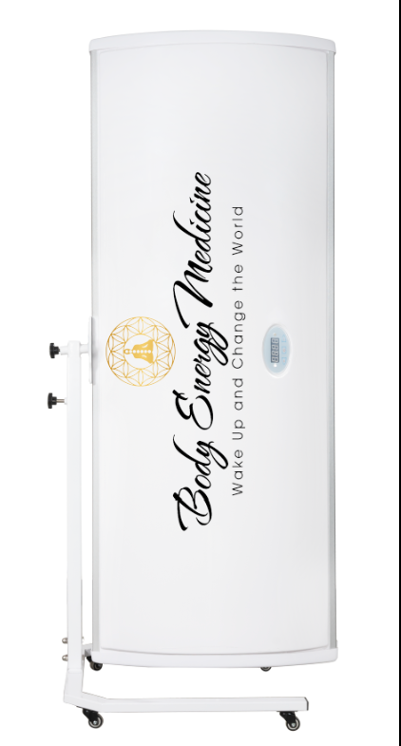
04
RLT machine
Helio Home Harmony (HHH)
Portable & Lightweight Design Light Therapy Canopy
Feature
360 degree rotation.
Lay-down or stand up therapy.
Flexible and saving space.
Physicl button, built-in timer.
8inches adjustable height.
Equipped with 4 wheels.

Slide 19
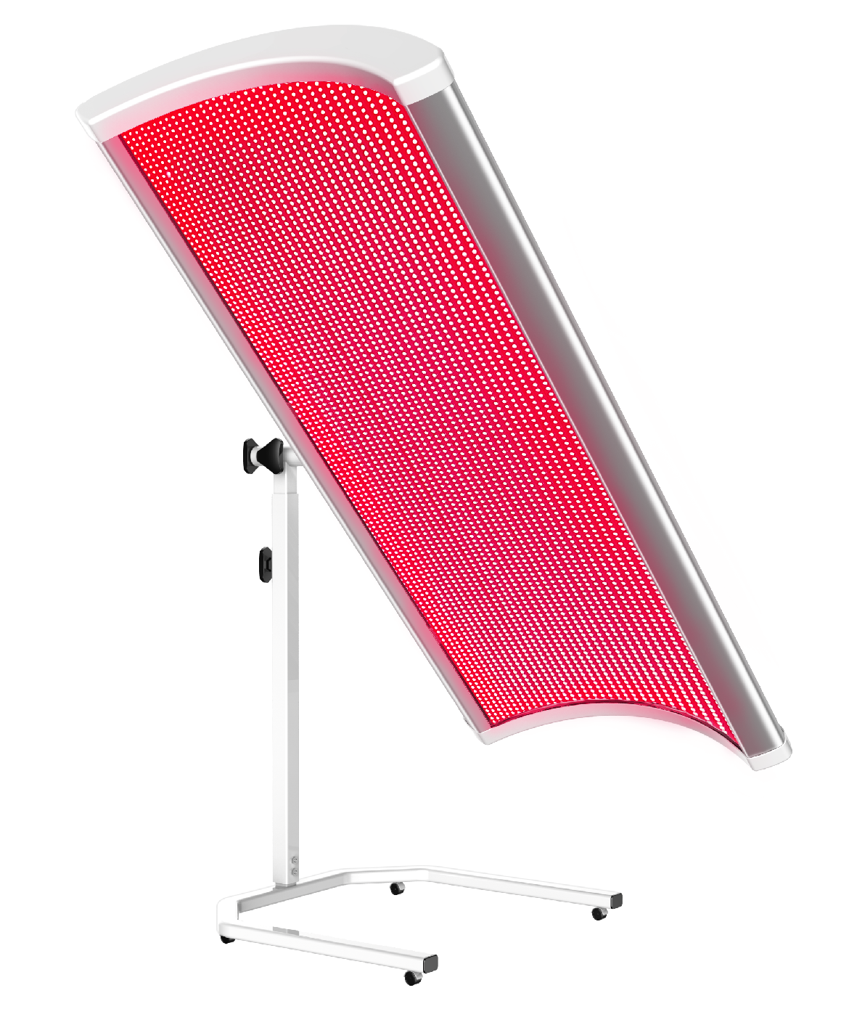
04
RLT machine
Helio Home Harmony (HHH)
Model | Helio Home Harmony (HHH)
Light | 38 LED strips (12312LEDs)
Wavelengths | 633nm:660nm:850nm:940nm
Total Power | 1000W
Session Time | 1-30 mins
Colors Available | White / Black
Voltage | 110V | 220V
Structure | 360 Degree Rotation
Control System | Three Buttons Control
Net Weight | 99LBS
Size | 74.5*28*12inches

Slide 20
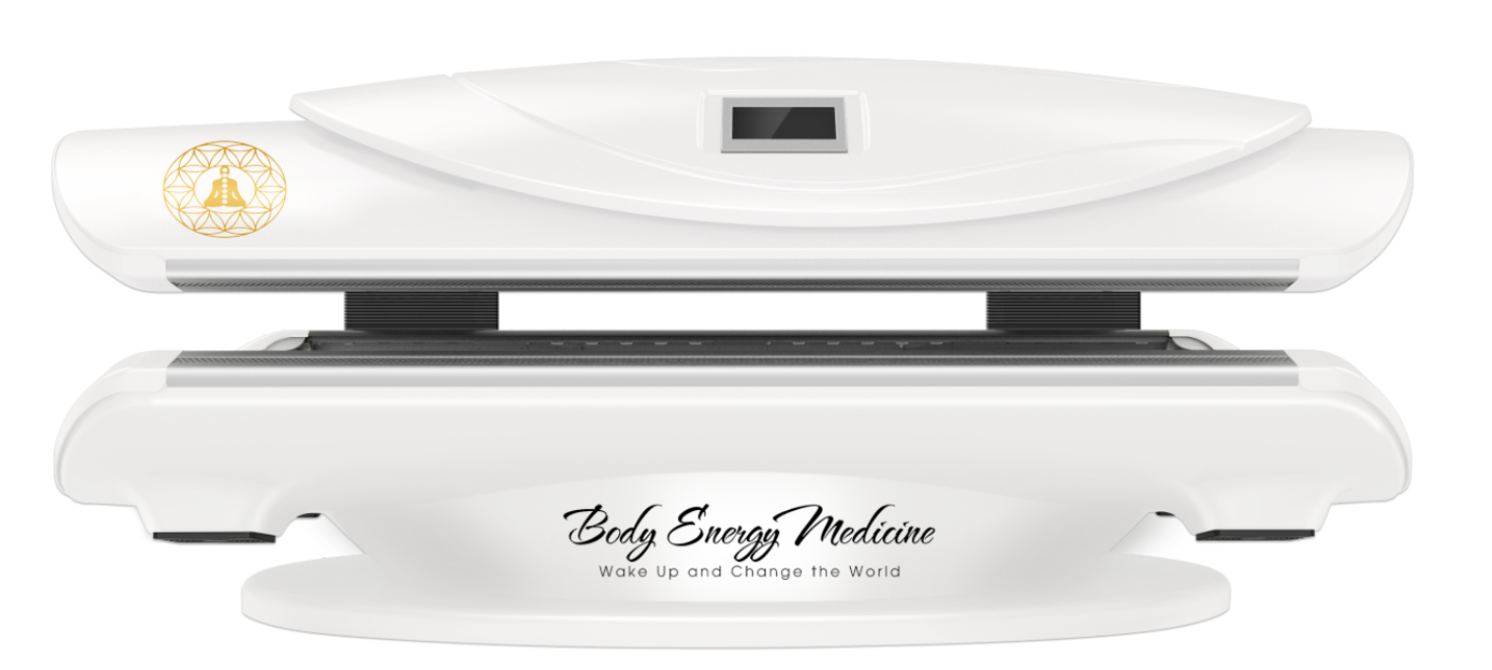
04
RLT machine
Spa Radiant Cradle (SRC)
Horizontal full body light bed, build in musical function.
Feature
Horizontal full body bed
ABS engineering plastics + aviation aluminum alloy,
Intelligent control system,independently control each wavelength,set frequency and duty,with wireless control tablet.
Equipped with surround sound system, support Bluetooth.

Slide 21
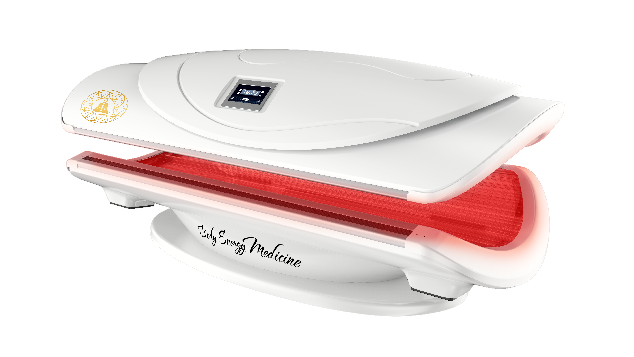
04
RLT machine
Spa Radiant Cradle (SRC)
Model | Spa Radiant Cradle (SRC)
Light | 26040PCS
Wavelengths | 633nm:660nm:810nm:850nm:940nm
Total Power | 3325 W
Session Time | 1-20 mins
Colors Available | White / Balck
Voltage | 220V
Control system | independently control each wavelength,set frequency and duty
Wireless control tablet | Yes
Cooling system | Yes
Net Weight | 550LBS
Size | 84.5*42*36inch(L*W*H)

Slide 22
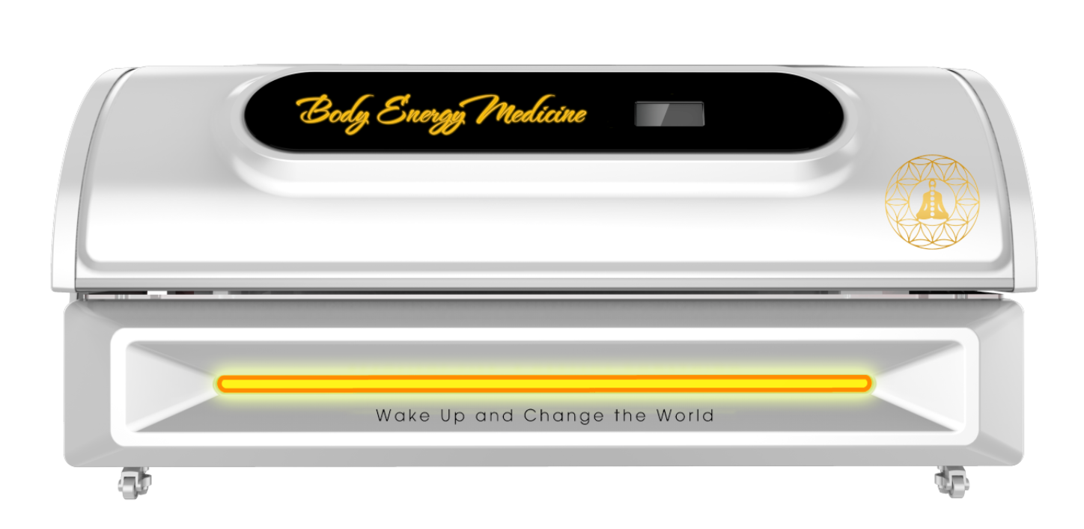
04
RLT machine
Radiant Revive Pro
360 whole body light bed, additional side cabin, build in musical function.
Feature
360 whole body flat bed, extra large space, flat surface.
ABS outer sheel + aviation aluminum alloy,
Intelligent control system,independently control each wavelength,set frequency and duty,with wireless control tablet.
4. Equipped with surround sound system, support
Bluetooth.

Slide 23
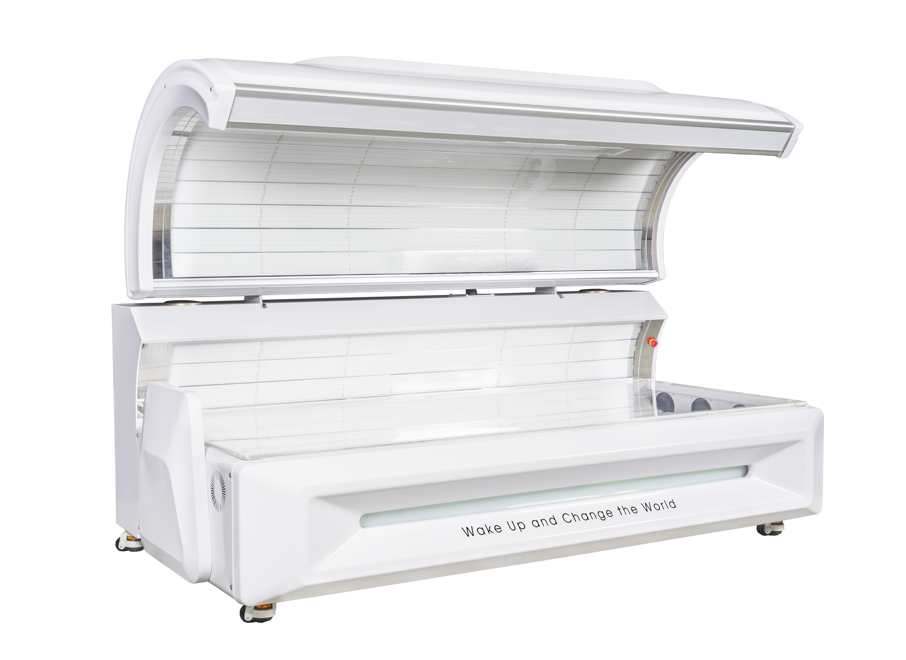
04
RLT machine
Radiant Revive Pro
Model | Radiant Revive Pro
Light | 41600PCS
Wavelengths | 633nm:660nm:810nm:850nm:940nm
Total Power | 5200 W
Session Time | 1-15 mins
Colors Available | White / Balck
Voltage | 220V
Control system | independently control each wavelength,set frequency and duty
Wireless control tablet | Yes
Cooling system | Yes
Net Weight | 880LBS
Size | 89.5*48.5*44inch(L*W*H)

Slide 24
RLT & Methylene blue
05

Slide 25
Cellular effects of combining Red Light Therapy (RLT) and Methylene Blue (MB).
05
RLT & Methylene blue
Mitochondrial synergy
01
ROS Modulation
02
Anti-Inflammatory Benefits
03
Brain Health
04

Slide 26
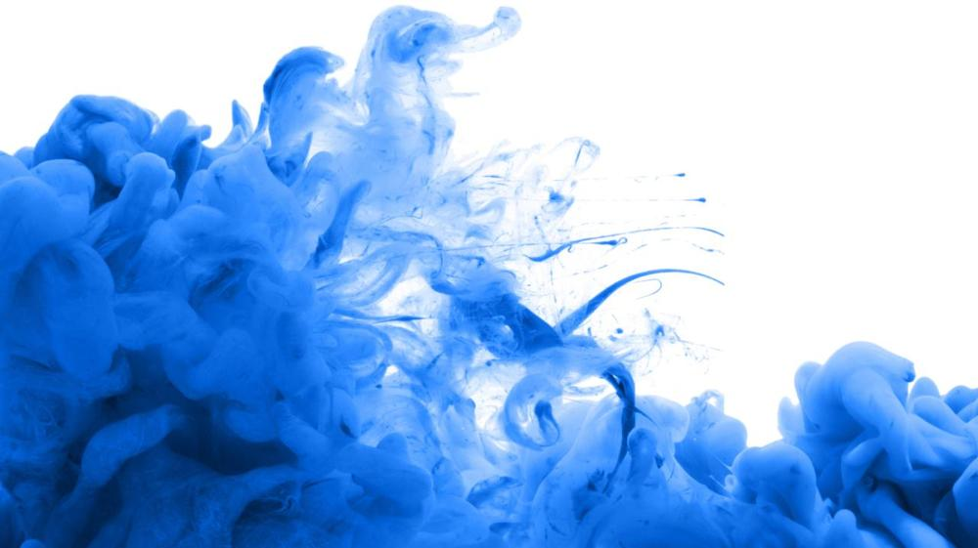
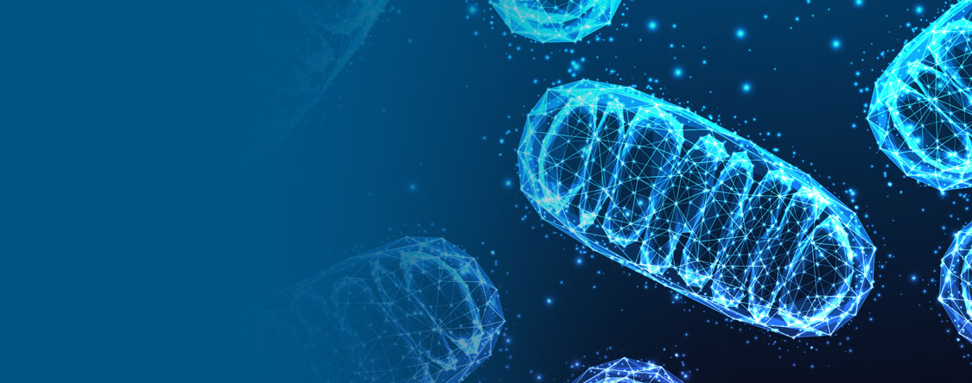
Mitochondrial synergy
Both RLT and MB interact with mitochondria, boosting energy production and cellular function.
"Mitochondrial synergy" typically refers to the cooperative interaction or collaboration between mitochondria, which are organelles found in eukaryotic cells responsible for generating energy in the form of adenosine triphosphate (ATP) through oxidative phosphorylation. Mitochondria are often referred to as the "powerhouses" of the cell due to their central role in energy production.

Slide 27
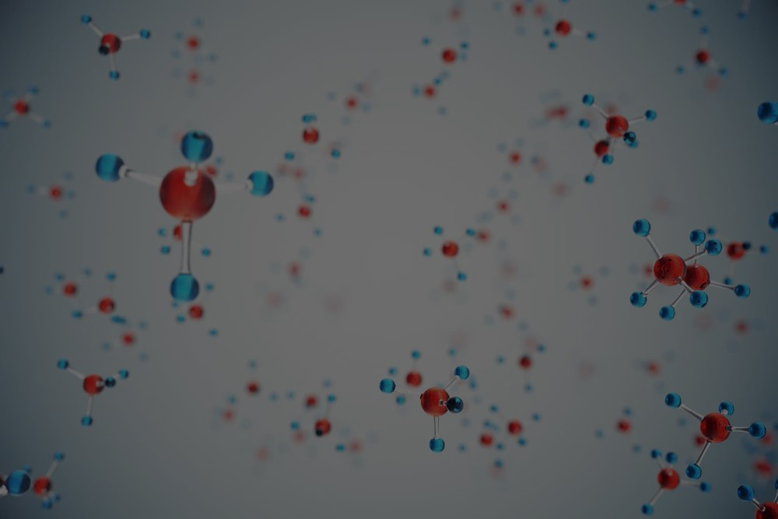
ROS Modulation
Reactive oxygen species (ROS) play a role in cellular signaling. The combination may fine-tune ROS levels.
ROS modulation refers to the regulation or control of reactive oxygen species (ROS) levels within cells. ROS are highly reactive molecules containing oxygen, such as superoxide radicals (O2−), hydrogen peroxide (H2O2), and hydroxyl radicals (•OH). While ROS are generated as natural byproducts of cellular metabolism, they can also be produced in response to various environmental stressors, such as UV radiation, toxins, or inflammation.

Slide 28
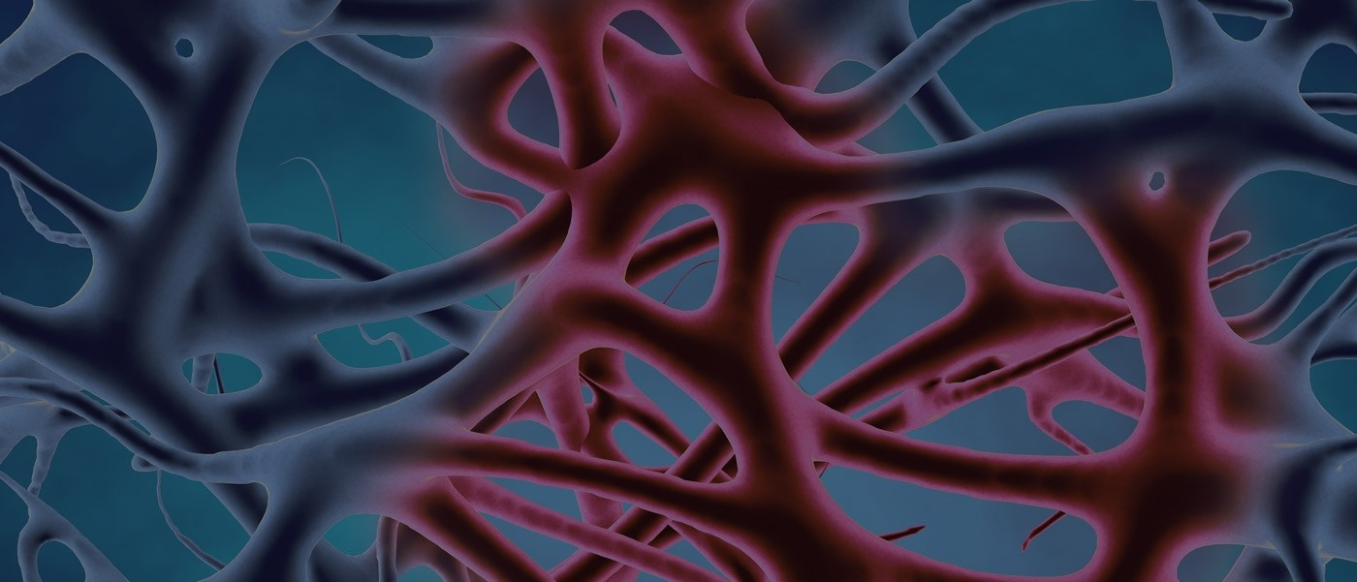
Anti-Inflammatory Benefits
Together, they may further reduce inflammation and promote tissue repair

Slide 29
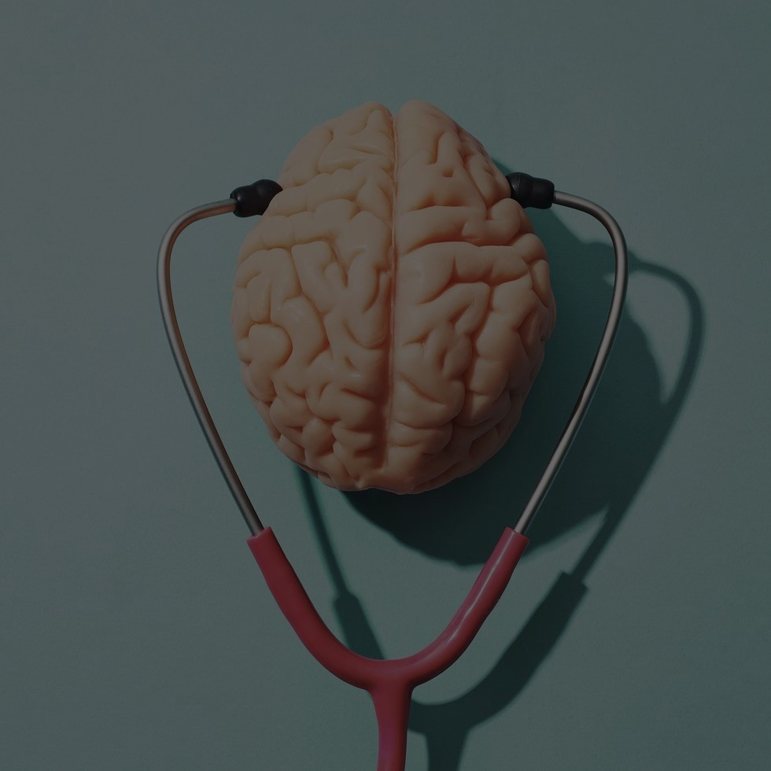
Brain Health
MB’s neuroprotective effects complement RLT’s potential cognitive benefits.
The statement suggests that the neuroprotective effects of Methylene Blue complement the potential cognitive benefits of Red Light Therapy. This implies that Methylene Blue may help protect neurons from damage or degeneration, while Red Light Therapy may enhance cognitive function. Together, these interventions could potentially offer a synergistic approach to promoting brain health and cognitive function.

Slide 30
Contact Us
Body Energy Medicine
13100 Wortham Center Dr #388 Houston Texas 77065. (3rd floor).
sandy@bodyenergymedicine.com
832-402-3389

